Slide 1
Seamless Banking System
ROVER-Team - 2

Slide 2
Team member roles:
S.NO | NAME | CONRTIBUTION
1 | Yoga Sri | Developer
2 | Niharika | Developer
3 | Sanjana | HTML/ Templates (Front End)
4 | Mohan Krishna | Tester and font end
5 | Harsha | Database Management

Slide 3
Description:
The Seamless Bank project aims to create an online banking platform focused on convenience, security, and accessibility, addressing issues like long processing times, complex interfaces, and limited personalization in traditional banking. Designed to streamline financial management for individuals and small businesses, this platform will use modern web technologies and user-centered design, offering essential banking services with a responsive interface across devices. The project supports financial inclusion, providing accessible banking to underserved groups and positioning our organization as an innovator in fintech.

Slide 4
Scope and Goal:
The Seamless Bank project will develop a secure, scalable web application enabling users to perform core banking tasks—account creation, fund transfers, transaction tracking, and accessing customer service. Emphasis will be placed on usability, security, and regulatory compliance to protect user data.

Slide 5
User Stories:
1. Account Registration User Story: As a user, I want to register for an account so that I can access banking services. Use Case: Register New User Actors: User, System Preconditions: The user has no existing account. Flow: User navigates to the registration page. User enters required details (e.g., name, email, password). System validates the input and checks for duplicates. System creates the user account and sends a confirmation. Postconditions: User account is created and activated.

Slide 6
User Stories:
2. Customer Service Inquiries User Story: As a user, I want to submit customer service inquiries so that I can get help with any issues I encounter. Use Case: Submit Customer Service Inquiry Actors: User, System, Customer Service Representative Preconditions: User is logged into the system. Flow: User navigates to the "Customer Service" section. User fills out the inquiry form describing the issue. System sends the inquiry to a customer service representative. Customer service responds to the user through the system. Postconditions: User receives a response and issue resolution.

Slide 7
User Stories:
3. Password Reset User Story: As a user, I want to reset my password if I forget it so that I can regain access to my account. Use Case: Reset Forgotten Password Actors: User, System Preconditions: The user has an account and has forgotten the password. Flow: User clicks on "Forgot Password". System prompts for email/phone number.

Slide 8
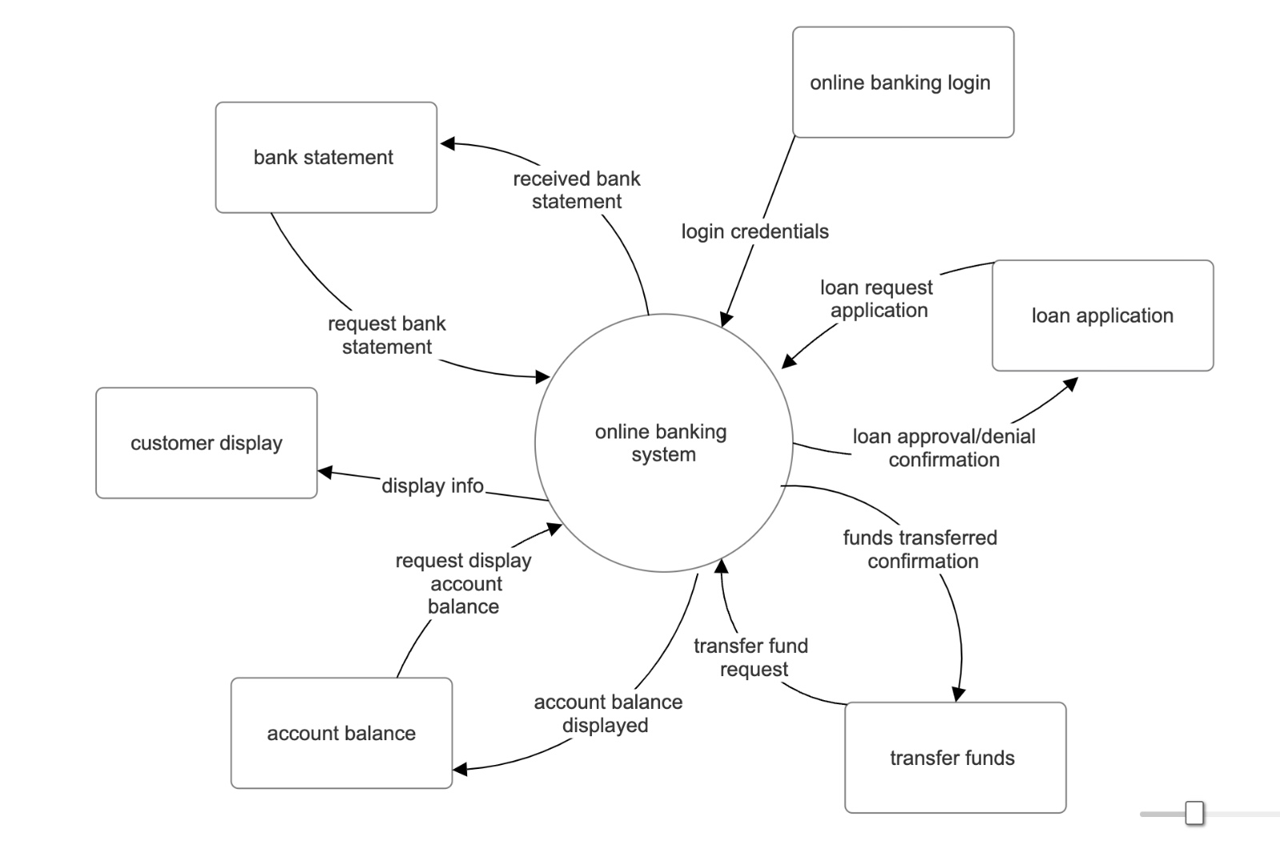
Context Diagram:

Slide 9
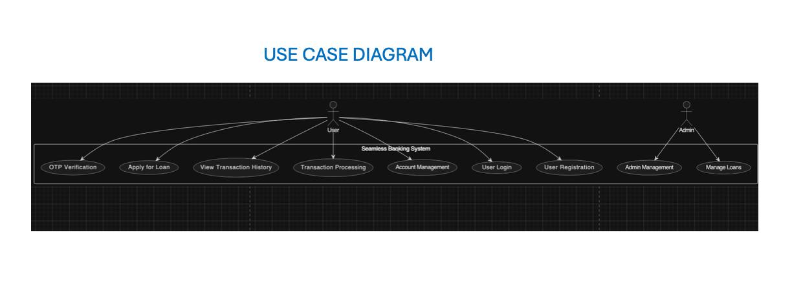

Slide 10
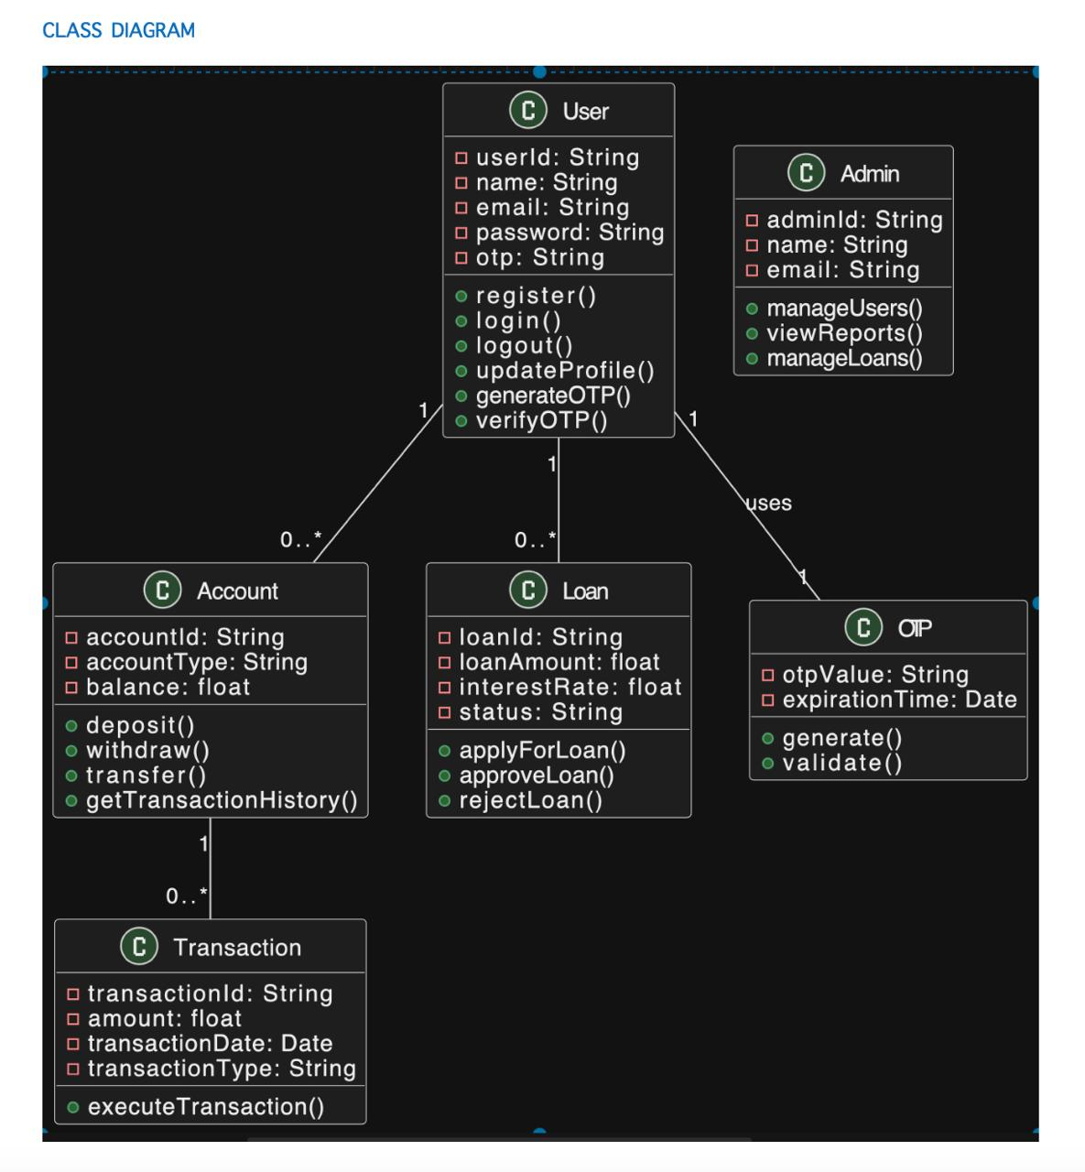

Slide 11
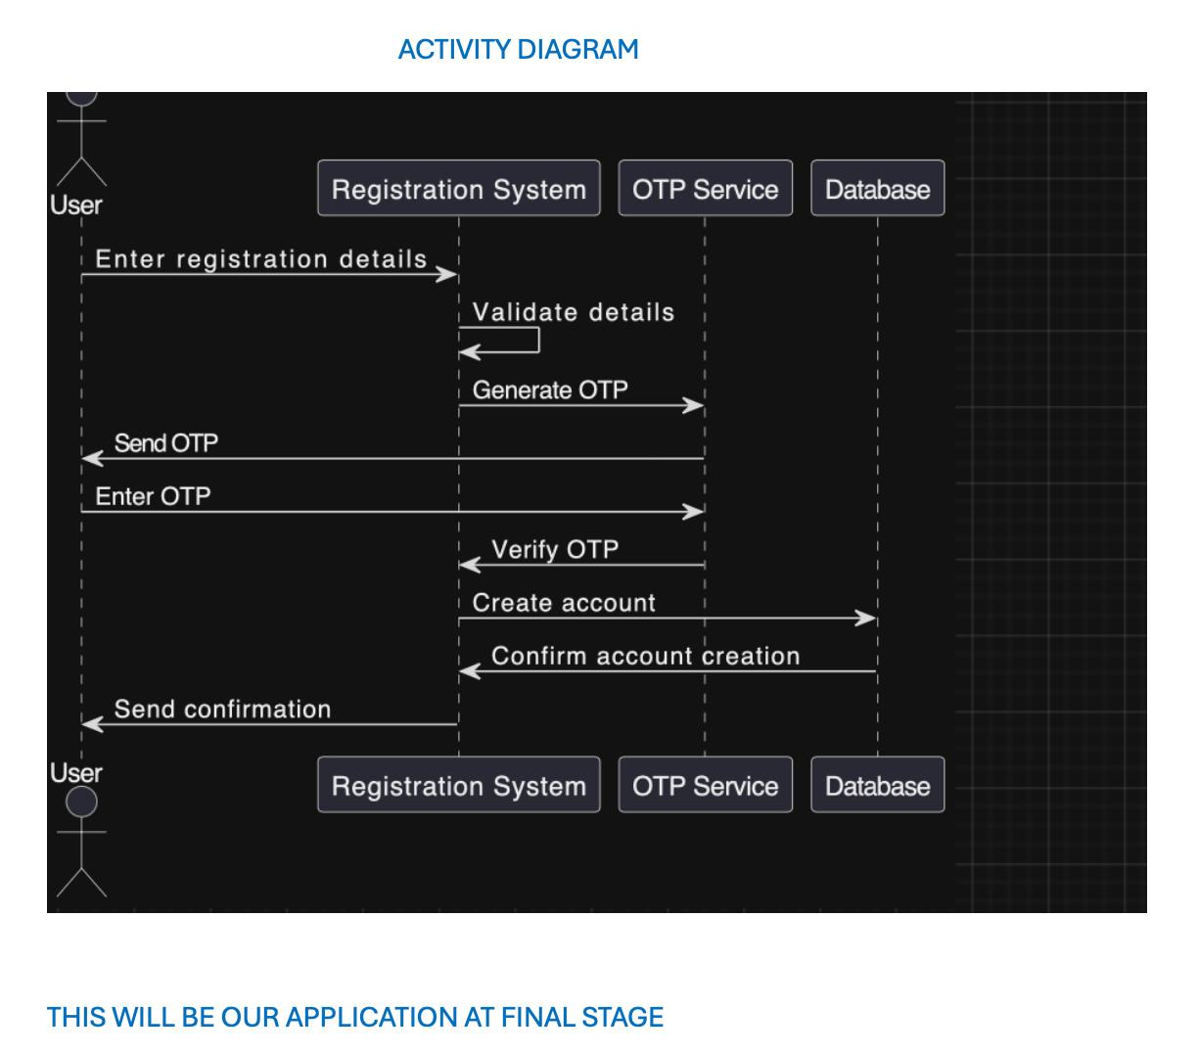

Slide 12
Product Backlog:
ID User Story | Priority | Status
1.Register new user account | High | Completed
2.Log in as existing customer | High | Completed
3.View account balance and transactions high | High | Completed
4.Transfer funds between accounts | High | Completed
5.Apply for and track loans | Medium | Completed
6. Raise a support ticket | Medium | Completed
7. Receive notifications for loans | Medium | To-do
8.Retrieve fraud transactions | High | Completed

Slide 13
Lessons Learned:
Verification and Testing : Even small mistakes can have a big effect on banking systems. To find and fix errors early in the development process, it was crucial to test often, especially for functionality like deposits, withdrawals, and account balance changes.
Comprehending Dependencies in Code Integration : Ensuring uniformity among team members code is crucial when dealing with numerous code sources or versions. The significance of frequent commits and making sure that everyone on the team has access to the same repository state was brought to light by missing code pieces during cloning.
Scalability through Modular Design :The system's modular design made it simple to add features like transaction management and loan processing without affecting its essential capabilities. In a banking system, where new services may be added as needs change, modular architecture is crucial.

Slide 14
Next Steps:
Receive notifications for loans:
Next we’ll focus on implementing a loan notification system. This feature will enable real-time alerts for loan status updates, repayments, and approvals. Notifications can be sent via multiple channels (SMS, email, or app notifications), ensuring customers stay informed and engaged with their loan details.

Slide 15
Git hub Link:
https://github.com/Yogasri-9093/SEAMLESS-BANK/blob/main/PRE%20FINAL%20(2).zip

Slide 16
Thank You

